Slide 1

Session-based Social Recommendation via Dynamic Graph
Attention Networks
方子玄
2019/5/20

Slide 2
Introduction
Online social communities are an essential part of today’s online experience.
Recommender systems for these platforms are therefore critical to surface information of interest to users and to improve long-term user engagement.

Slide 3
Challenges
User interests are dynamic by nature. A user may be interested in sports items for a period of time and then search for new music groups.
Since online communities often promote sharing information among friends, users are also likely to be influenced by their friends. For instance, a user looking for a movie may be influenced by what her friends have liked.
The set of influencers can be dynamic since they can be context-dependent. For instance, a user will trust a set of friends who like comedies when searching for funny films; while she could be influenced by another set of friends when searching for action movies

Slide 4
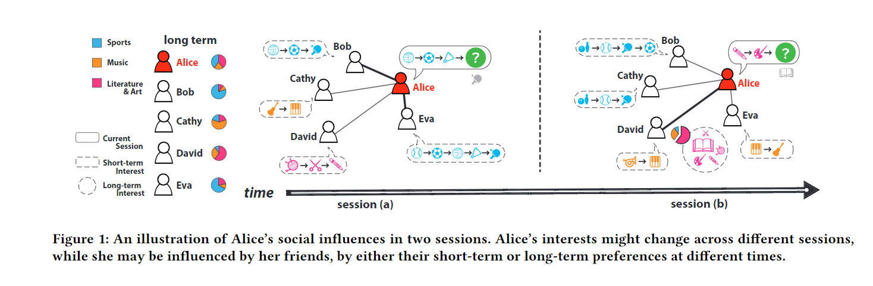

Slide 5
contributions
Propose to study both dynamic user interests and context-dependent social influences for the recommendation in on-line communities.
Propose a novel recommendation approach based on dynamic-graph-attention networks for modeling both dynamic user interests and context-dependent social influences. The approach can effectively scale to large data sets.
Conduct extensive experiments on real-world data sets. Experimental results demonstrate the effectiveness of our model over strong and state-of-the-art baselines.

Slide 6
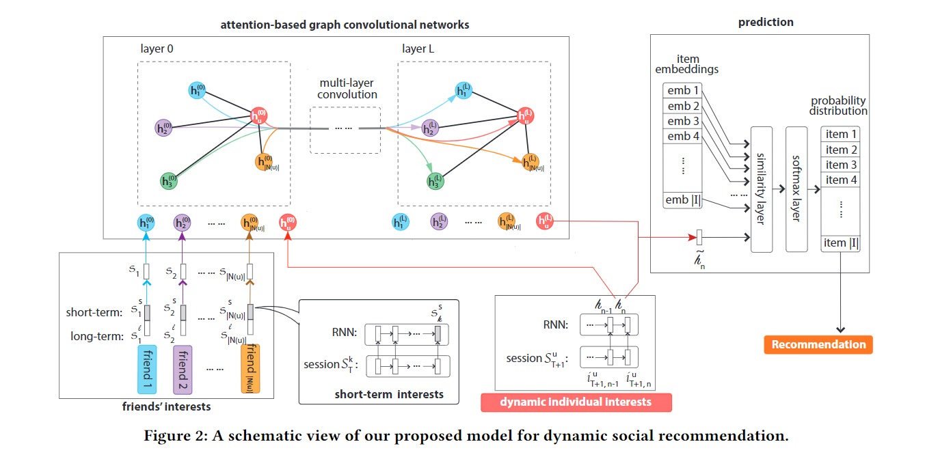
DYNAMIC SOCIAL RECOMMENDER SYSTEMS
a recurrent neural network (RNN) models the sequence of items consumed in the (target) user’s current session.
The short-term preferences, or items in their most recent session, are also encoded using an RNN. Friends’ long-term preferences are encoded with a learned individual embedding.
The model then combines the representation of the current user with the representations of her friends using a graph-attention network .
The proposed mechanism learns to weigh the influence of each friend based on the user’s current interests.

Slide 7
DYNAMIC SOCIAL RECOMMENDER SYSTEMS
We obtain this combined representation using a novel graph-attention network.
First, we encode the friendship network in a graph where nodes correspond to users (i.e., target users and their friends) and edges denote friendship. In addition, each node uses its corresponding user’s representation as (dynamic) features.
Second, these features are propagated along the edges using a message-passing algorithm.
The main novelty of our approach lies in using an attention mechanism to weigh the features traveling along each edge.
After a fixed number of iterations of message passing, the resulting features at the target user’s node are the combined representation.

Slide 8
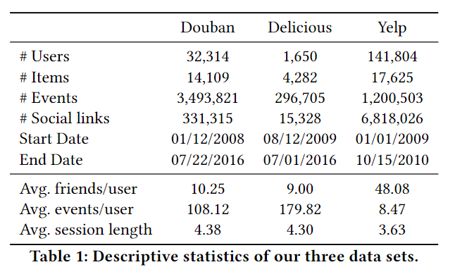
EXPERIMENTS

Slide 9
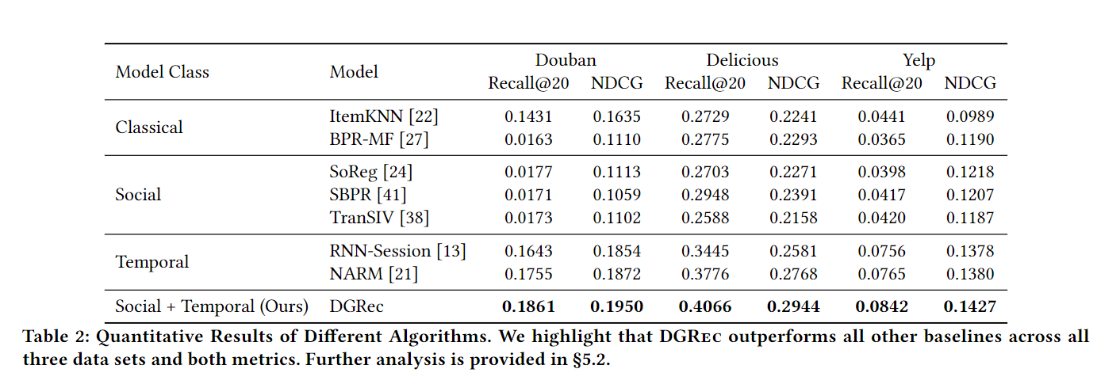
EXPERIMENTS

Slide 10
Thanks!

